Slide 1
Mapping Yap’s Culture of Cultivation
A Graduate Student’s Experience

Slide 2
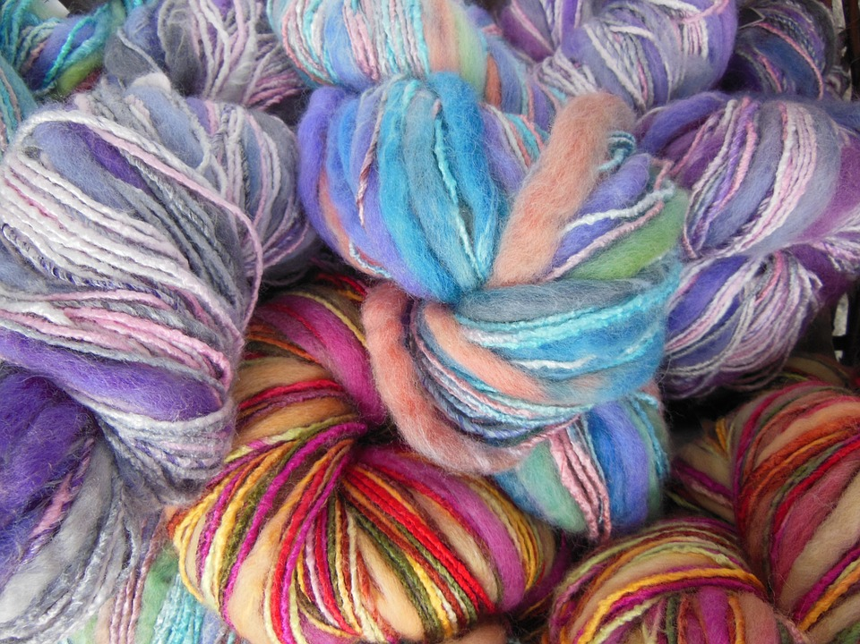
Creative Commons

Slide 3

Design With Nature
Ian McHarg’s Design with Nature Cover Art

Slide 4
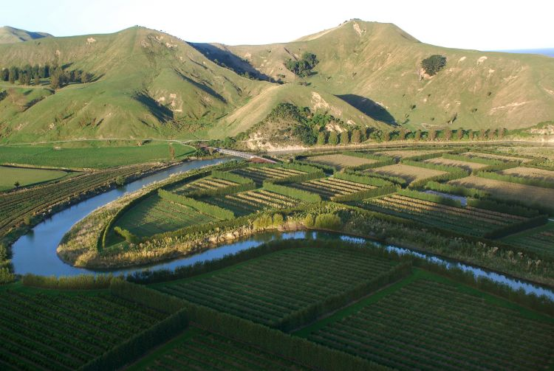
Productive landscapes
Nelson Byrd Woltz Landscape Architects. http://www.nbwla.com/projects

Slide 5
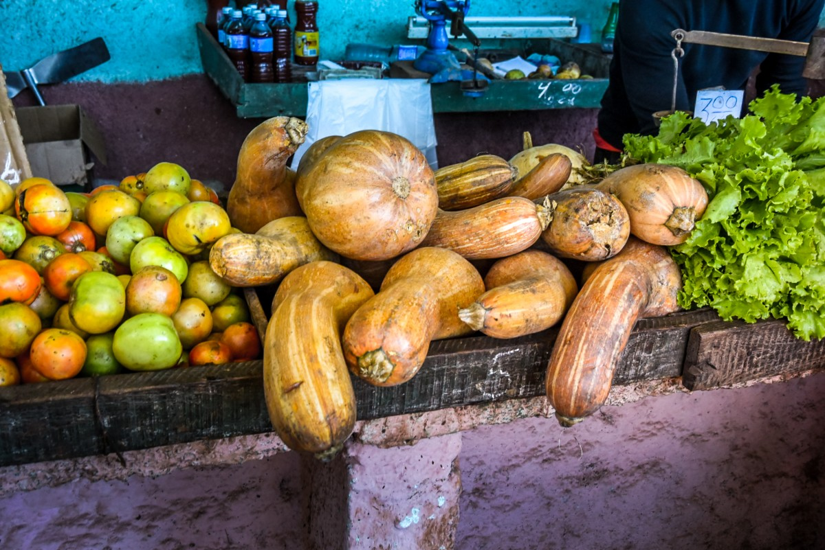
Creative Commons

Slide 6
Yap, Micronesia

Slide 7
CULTIVATE verb cul·ti·vate \ ˈkəl-tə-ˌvāt \
From Latin CULTUS, Latin past participle stem COLERE meaning
to care, worship
to foster, maintain
to live in (place), inhabit
to labor
to tend, promote growth
CULTURE noun cul·ture \ ˈkəl-chər \
derived from Latin CULTURA, past participle stem COLERE
http://latin-dictionary.net; https://www.merriam-webster.com

Slide 8
Where I’ve Been…
CLASS - Advanced Topics in Geographic Information Systems
PROJECT – Mapping Yap’s Culture of Cultivation:
Research Review &
Pilot Study of Subsistence Garden Networks
on the High Islands of Yap, Micronesia
CLASS - Modelling Geographic Space
PROJECT - Automated Suitability and Assessment Models
CLASS - Organizational
Dynamics:
Sustainability & Entrepreneurship
PAPER – Conceptual Frameworks for a Sustainable Panama City
Iterative Approach
GIS Modelling Tools

Slide 9
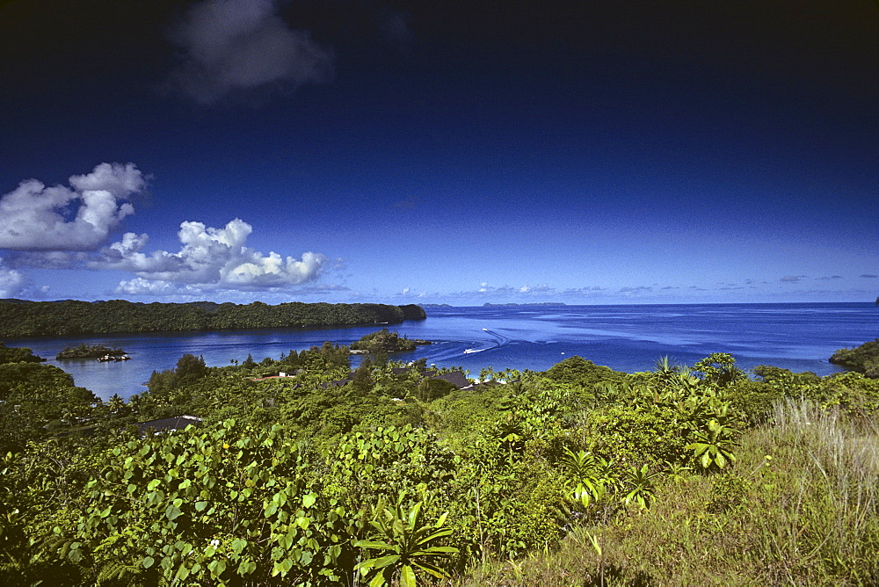
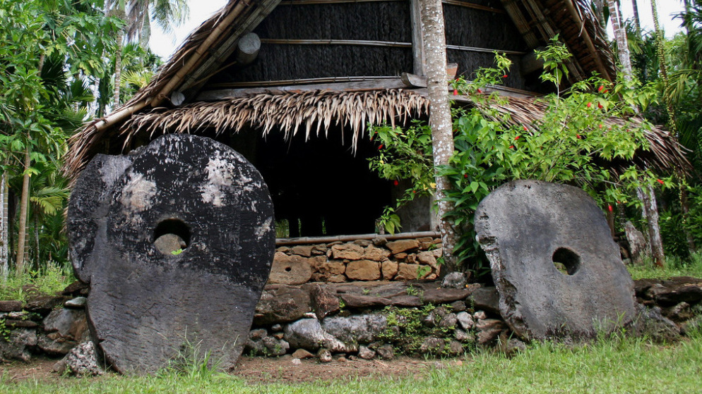

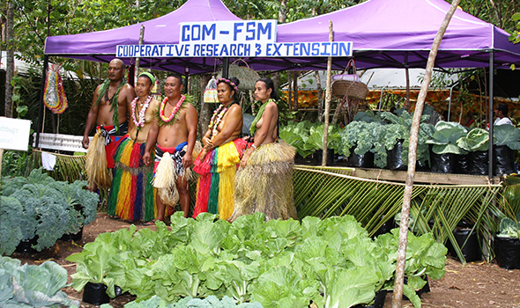
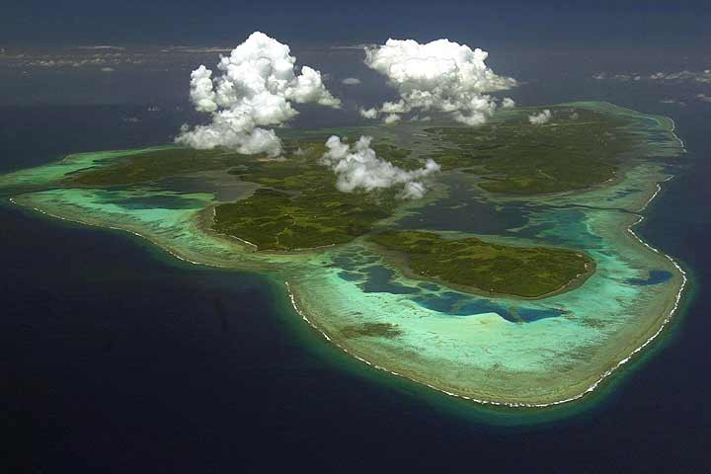

Where I’m Going…
For List of Credits See Last Page of this Presentation

Slide 10
Imagery to Information
Maximum Likelihood Classification & Iso Cluster Unsupervised ClassificationTools

Slide 11
Approach
Conditions
Critical part of the cycle is revision of criteria based on new information, greater detail in data, or evolving issues and concerns
Potential Outcomes
Forward-
Thinking
Ideas
Suggestions

Slide 12
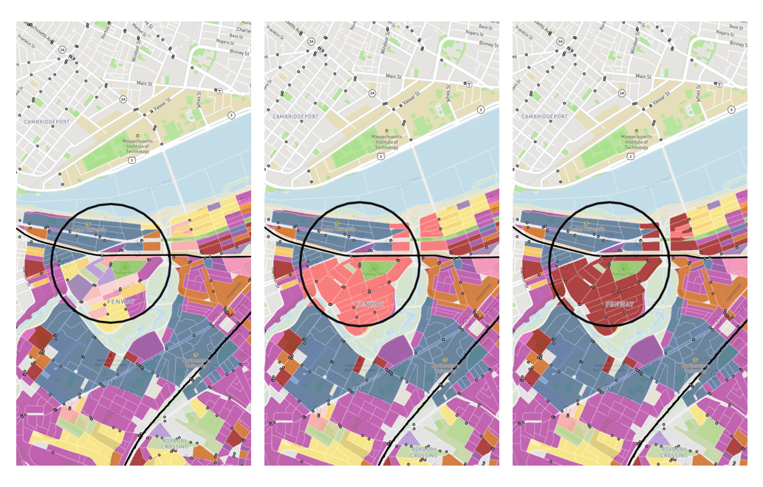
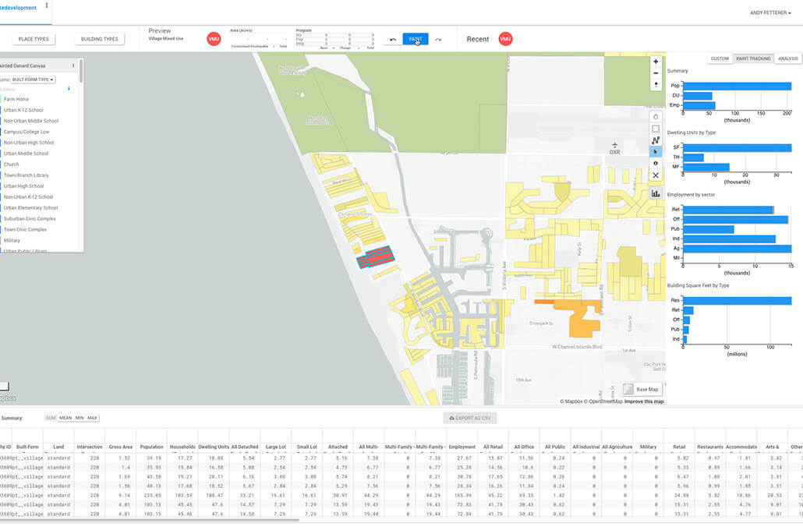
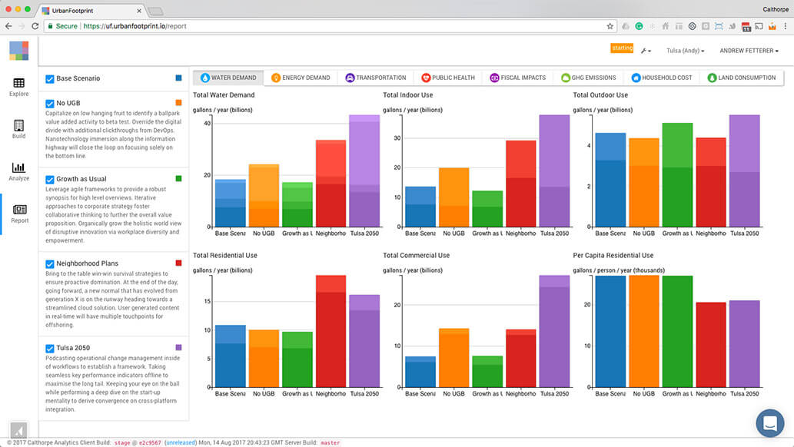
Applications
URBAN FOOTPRINT https://urbanfootprint.com/

Slide 13
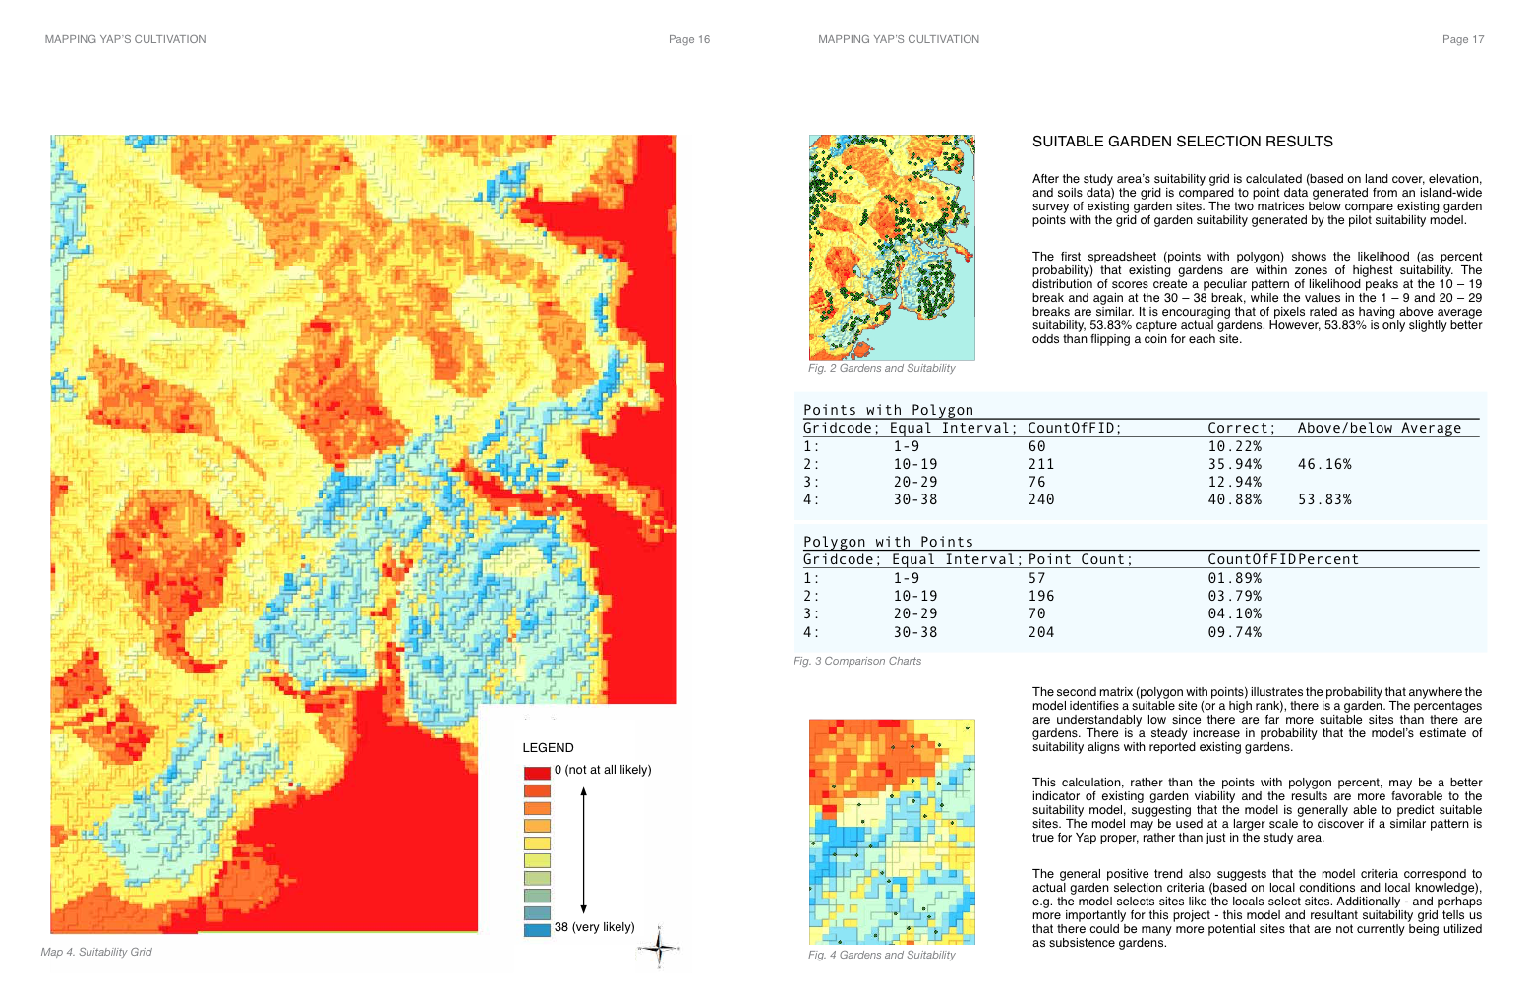
Suitability Model
Overlay concept:
Lowland areas
Within forests or forest clearings
Within mixed tree forests or home gardens
On slopes of less than 20%
TO INCLUDE FOR FUTURE STUDIES:
Around ditches and/ or small rock or earthen dams

Slide 14
Validation
Equal Interval | Point Count | Count of FID (%)
1 - 9 | 57 | 81.89%
10 -19 | 196 | 83.79%
20 - 29 | 78 | 84.18%
30 - 38 | 284 | 89.74%

Slide 15
Network Assessment Model
Using the existing garden survey point data, this segment of the study attempts to establish a GIS process for assessing the relationship between producers (gardens) and consumers (hypothetical villages).
For the purposes of this exercise:
All gardens are approximately ¼ acre.
The yield from each garden is estimated at 2,660.50 pounds of produce annually. This calculation is based on Annual Production Averages per Acre = 10,642 – 10,840 pounds. These numbers could be easily adjusted in a model, should new or different information become available.
Household populations are allocated to the village to which they are closest.
All people consume 1,996 pounds of food annually. Consumption values are established by number of people in each village and an average of 1,996 estimated annual food consumption. This metric is originated from economists who crunched the U.S. Department of Agriculture’s food consumption data.
It is assumed that ¾ of all food consumed is of a vegetable variety that might be grown in the mapped subsistence gardens.
Time related to seasonality of harvest and food storage is not taken into consideration in these calculations.

Slide 16
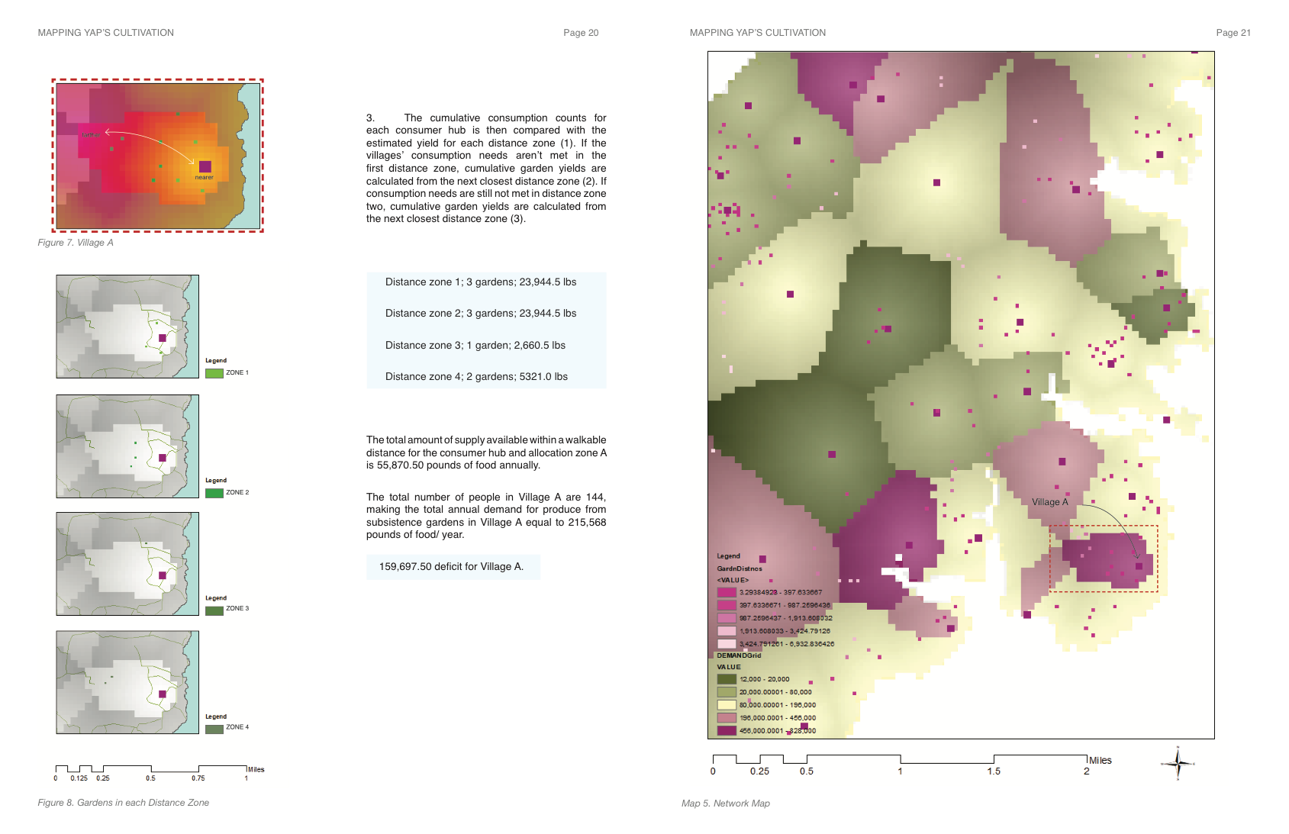

Slide 17
Hybridization of Models
”System dynamics
(SD) methodology is uniquely suited to investigate [ agriculture and natural resource management]
given their inherently complex behaviors.”
-Turner 2016
System Dynamics and Agent-Based models have been attracting more attention as viable methodologies due to “conceptual and structural advantages that they
provide to the study of food system complexity”
- Monesterolo 2016
Millington, James, et. al. 2017.

Slide 18
Mapping Yap’s Culture of Cultivation:
Research Review &
Pilot Study of Subsistence Garden Networks
on the High Islands of Yap, Micronesia
Automated Suitability and Assessment Models
Conceptual Frameworks for a Sustainable Panama City

Slide 19
References and Image Credits
Perkins, Reed; Krause, Stephen. Unpublished. Adapting to Climate Change Impacts in Yap State, Federated States of Micronesia: The Importance of Environmental Conditions and Intangible Cultural Heritage.
Petersen, Glenn. 2009. Traditional Micronesian Societies: Adaptation, Integration, and Political Organization in the Central Pacific. Honolulu: University of Hawai’i Press. Project MUSE. Retrieved from: https://muse.jhu.edu/.
Tomlin, C. D. 1990. Mapping What isn’t there. Prescriptive Modeling. In Geographic Information Systems and Cartographic Modeling. Ch. 8. Wichmann-Verlag, Berlin, Germany: Prentice-Hall
Tomlin, C. D. 2012. Speaking of GeoDesign. GIS Science Journal, February, 2012.
Tomlin, C. D. 2012. Fundamentals of geospatial algorithm design. Foundations of Urban and Regional Information Systems and Geographic Information Systems and Science.
Nature Editorial Report. (2003).
Monesterolo, I., et. al. (2016). Sustainable and Inclusive Food Systems through the Lenses of a Complex System Thinking Approach—A Bibliometric Review. Agriculture, 6, 44.
Turner, B. et. al. (2016). System Dynamics Modeling for Agricultural and Natural Resource Management Issues: Review of Some Past Cases and Forecasting Future Roles Resources, 5, 40.
Millington, James, et. al. 2017. Integrating Modelling Approaches for Understanding Telecoupling: Global Food Trade and Local Land Use. Land, 6, 56.
Image Credits
Page 3 Ian McHarg Design with Nature Cover Art
Page 4 Nelson Byrd Woltz Landscape Architects
Page 6 ESRI Open Street Map Imagery
Page 12 Urban Footprint
Credits for images on page 9 (top left to bottom right)
Robert Harding “Looking Looking out over forest covered inlet with houses and motor boats, Yap Island, Yap, Federated States of Mirconesia”
“The Island of Stone Money,” tropical.pete/Flickr
Assembly House, Photograph by Robert Harding
www.micronesialandgrant.org/
Manta Ray Bay Dive Resort Aerial Image
Shutterstock (http://ak3.picdn.net/shutterstock/videos/5090813/thumb/1.jpg, http://ak3.picdn.net/shutterstock/videos/5090813/thumb/1.jpg)

